Slide 1
Employee Data Analysis using Excel
STUDENT NAME: Pooja R
REGISTER NO: asunm10942552 & 312200993 DEPARTMENT: B.com General
COLLEGE : DRBCCC Hindu College

Slide 2
Project Title!
Employee Salary analysis

Slide 3
AGENDA
1 | Problem Statement
2 | Project Overview
3 | End Users
4 | Our Solution and Proposition
5 | Dataset Description
6 | Modelling Approach
7 | Results and Discussion
8 | Conclusion

Slide 4

Problem Statement
The organization seeks to ensure that its compensation structure is equitable, competitive, and aligned with industry standards. However, there is currently limited visibility into salary distribution across departments, job roles, and employee demographics. Additionally, potential disparities in pay related to gender, race, or tenure are not well understood. This analysis aims to identify any inconsistencies or gaps, assess salary competitiveness in the market, and provide actionable insights to ensure fair and transparent compensation practices.

Slide 5
Project Overview
The Employee Salary Analysis project aims to evaluate the company’s current salary structure to ensure it is fair, competitive, and aligned with both internal policies and external market trends. The analysis will involve assessing salary distribution across various departments, roles, and demographic groups (e.g., gender, ethnicity, tenure) to identify any disparities or trends. Additionally, the project will compare current salaries against industry benchmarks to evaluate the competitiveness of the company’s compensation strategy.

Slide 6
WHO ARE THE END USERS?
Human Resource Department
Executive Leadership/Management:
Employees
Finance Team
Recruiters

Slide 7
Our Solution And Its Value Proposition
Our solution is a comprehensive Employee Salary Analysis that delivers detailed insights into the company’s salary structure, addressing pay equity, market competitiveness, and salary distribution. Through a data-driven approach, we assess internal salary data across departments, roles, and demographics, compare it to industry benchmarks, and provide actionable recommendations for improvement.
Data Collection and Analysis: We gather salary data by role, department, tenure, gender, and other demographics to identify patterns and potential disparities.
Equity and Fairness: We conduct a pay gap analysis to identify and address any inequalities, ensuring fairness across all employee demographics.
Salary Growth Tracking: We analyze historical salary trends to assess career progression and ensure consistent salary increases.

Slide 8
Dataset Description
Employee ID
Name
Department
Job Title
Years of ExperienceSalary (USD)
Bonus Percentage.

Slide 9
THE "WOW" IN OUR SOLUTION
Clear Pay Equity Solutions: We identify pay gaps and offer specific actions to fix them, ensuring fairness for everyone.
Up-to-Date Market Comparisons: Our tool compares salaries with the latest market data to keep your pay competitive.
Interactive Dashboards: Easy-to-use visual dashboards let you explore salary data in real-time for quick insights.Salary
Growth Predictions: We forecast future salary trends, helping you plan for raises and budget more effectively.
Custom Action Plans: Personalized recommendations help you adjust salaries, bonuses, and pay scales with practical steps.

Slide 10
MODELLING
Salary Distribution: Analyze how salaries are spread across roles and departments.
Pay Equity: Identify and address pay gaps related to demographics.
Market Comparison: Compare company salaries with industry benchmarks.
Growth Prediction: Forecast future salary increases based on trends.
Turnover Risk: Predict potential employee turnover due to salary issues.
Total Compensation: Evaluate the complete compensation package, including bonuses and benefits.

Slide 11
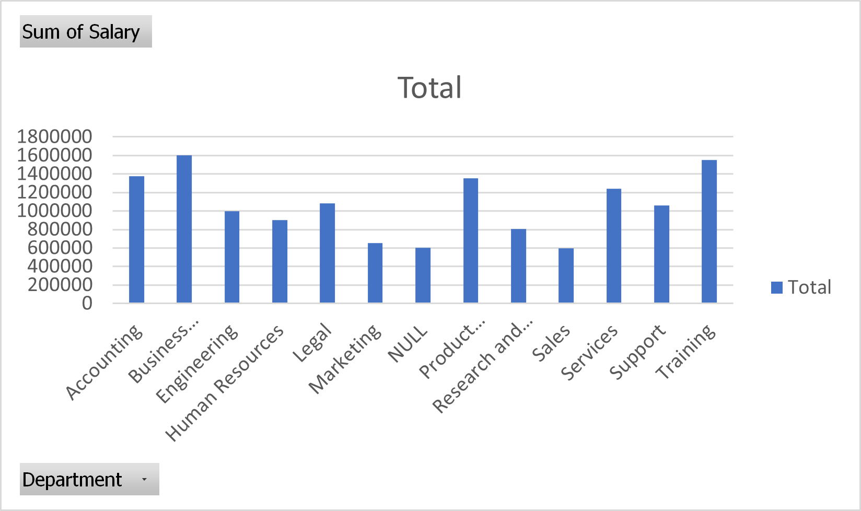
Results

Slide 12
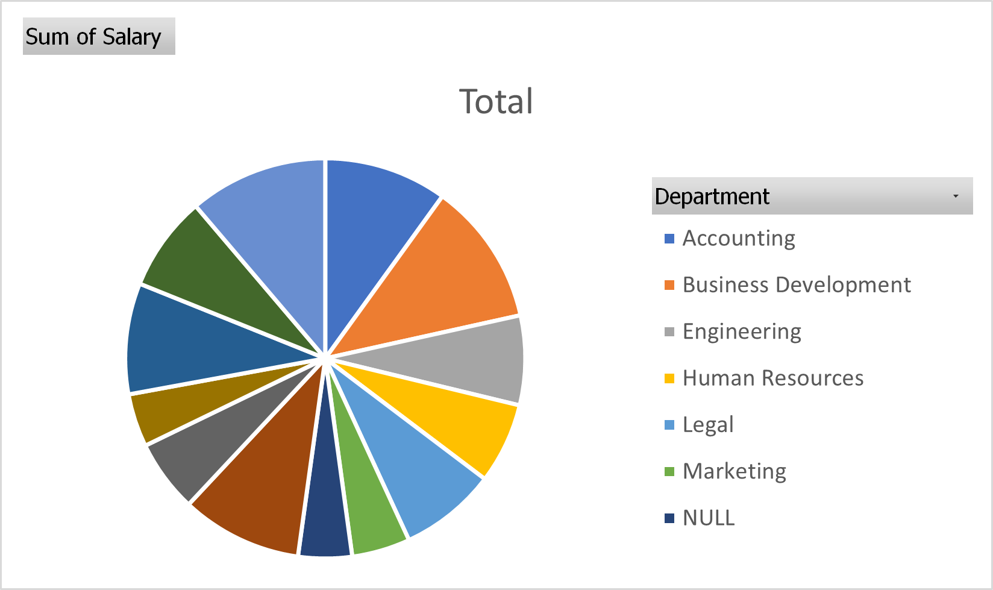
Results

Slide 13
Conclusion
The Employee Salary Analysis provides critical insights into how compensation is structured across the organization. Through data-driven modeling, it helps ensure fairness, equity, and competitiveness in employee pay. By identifying salary gaps, predicting growth, and benchmarking against market standards, organizations can make informed decisions to improve employee satisfaction, retain top talent, and stay competitive in the industry. The analysis offers a pathway to creating a transparent and balanced compensation strategy that aligns with both employee expectations and business goals.

